Slide 1
Azure mixed reality cloud services overview
+Azure Remote Rendering
+Azure Spatial Anchors

Slide 2
Azure Spatial Anchors Application
Way-finding: Where two or more spatial anchors could be connected to create a task list or points of interest a user must interact with.
Multi-user experiences: Where users could pass moves back and forth by interacting with objects in the same virtual space.
Persisting virtual content in the real-world: Where users could place virtual objects in the real-world that are viewable from other supported devices.

Slide 3
Azure Object Anchors
+ Automatically aligning 3D content with physical objects (Gain contextual understanding of objects without the need for markers or manual alignment. Save significant touch labor, reduce alignment errors, and improve user experiences by building mixed reality applications with Object Anchors).
Training: Create Mixed Reality training experiences for your workers, without the need to place markers or spend time manually adjusting hologram alignment.
Task Guidance: Walking employees through a set of tasks can be greatly simplified when using Mixed Reality.
Asset Finding: If you already have a 3D model of some object in your physical space, Azure Object Anchors can enable you to locate and track instances of that object in your physical environment.

Slide 4
Azure Object Anchors overview
Azure Object Anchors enables an application to detect an object in the physical world using a 3D model and estimate its 6DoF pose. The 6DoF (6 degrees of freedom) pose is defined as a rotation and translation between a 3D model and its physical counterpart, the real object.
The Azure Object Anchors model is used along with the runtime SDK to enable a HoloLens application to load an object model, detect, and track instance(s) of that model in the physical world.
https://docs.microsoft.com/en-us/azure/object-anchors/overview

Slide 5
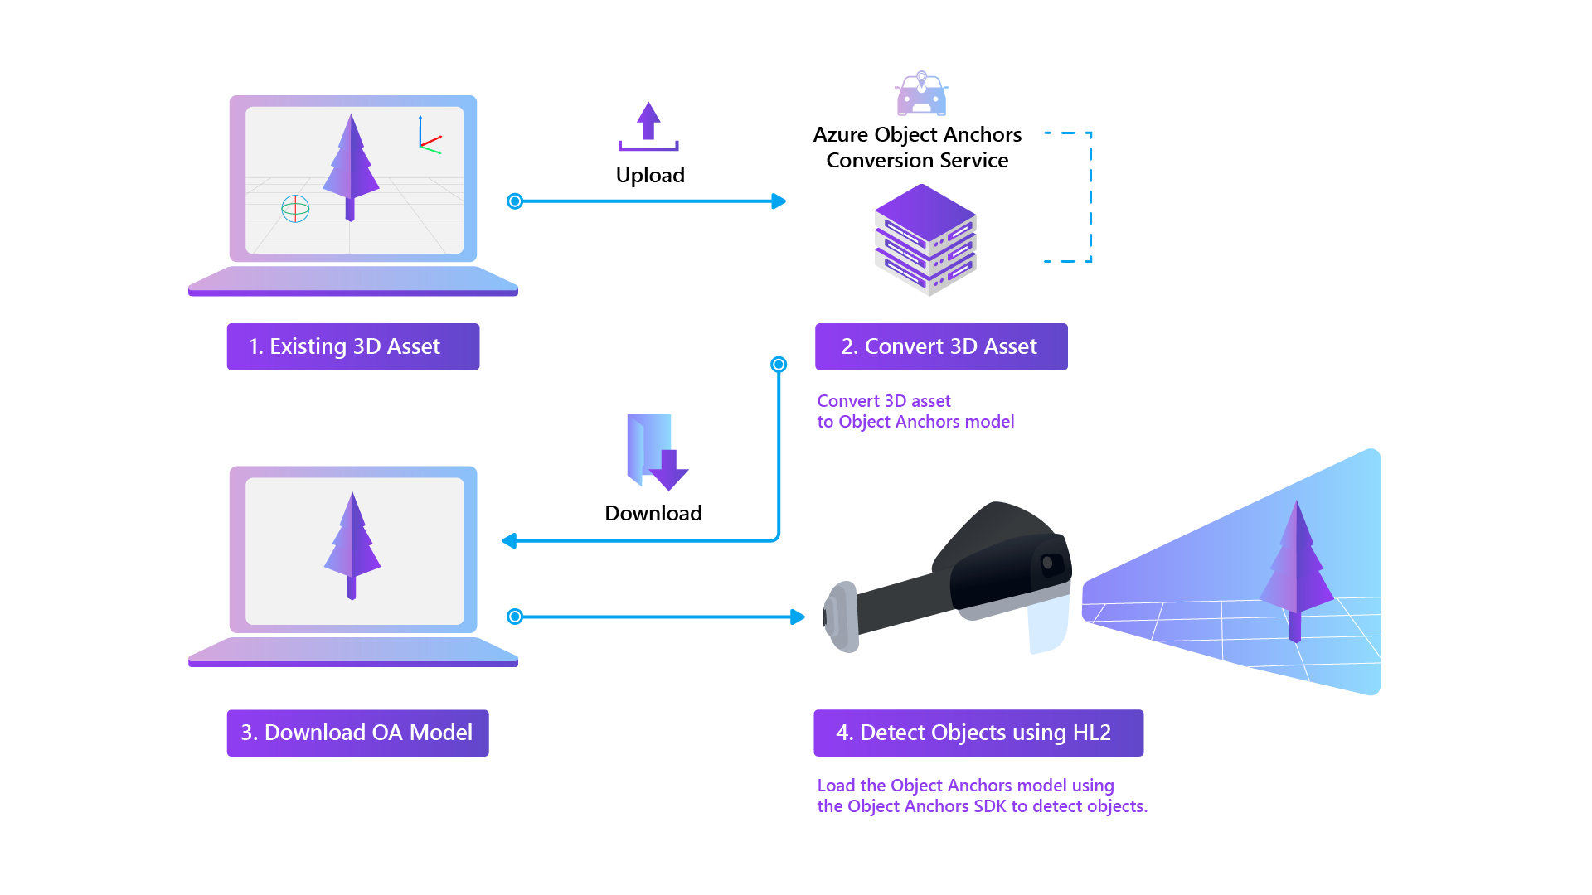
Usage flow

Slide 6
Asset requirements
Each dimension of an asset should be between 1 meter to 10 meters, and the file size should be less than 150 MB.
The asset formats currently supported are: fbx, ply, obj, and glb.

Slide 7
Create a HoloLens app with Azure Object Anchors, in Unity with MRTK
+ Enable object-aware mixed reality experiences for the HoloLens
Account domain
eastus2.mixedreality.azure.com
Account ID
424d414d-0b1f-46c2-ae5d-f19b46ad8955
Primary key
ra1sJxYeWHNiSep4yKj/rMUvKX2Ipwbl0MzL7UwVjew=

Slide 8
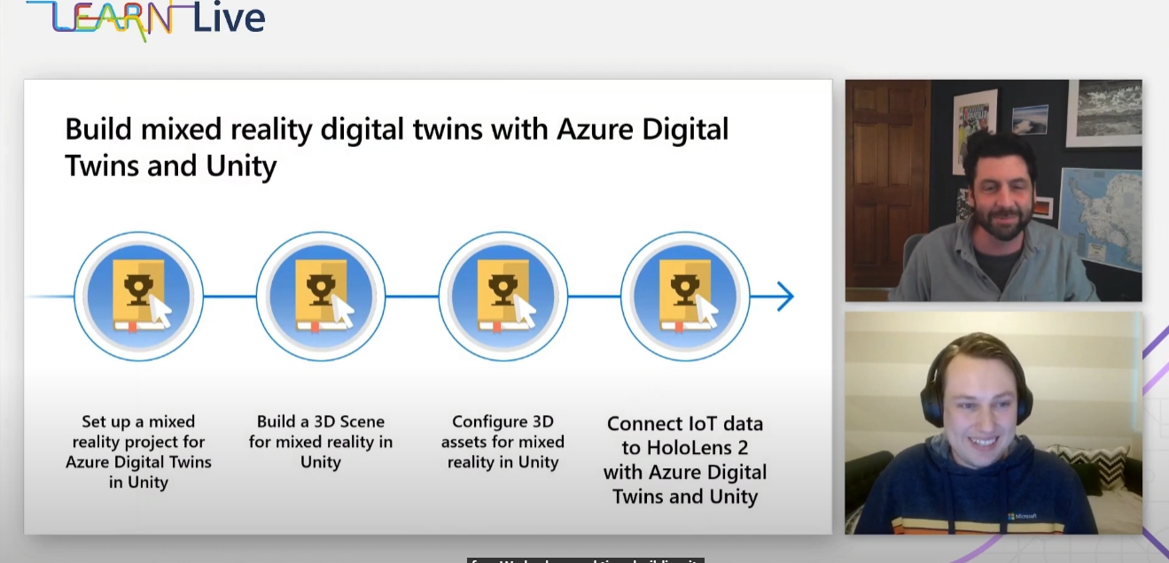
Connect IoT data to HoloLens 2 with Azure Digital Twins and Unity | CON064
https://www.youtube.com/watch?v=z887pR8pVSA

Slide 9
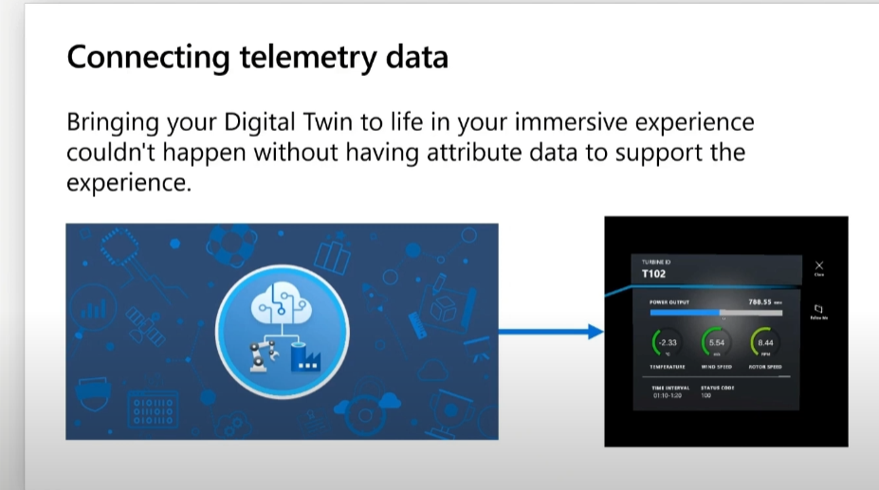
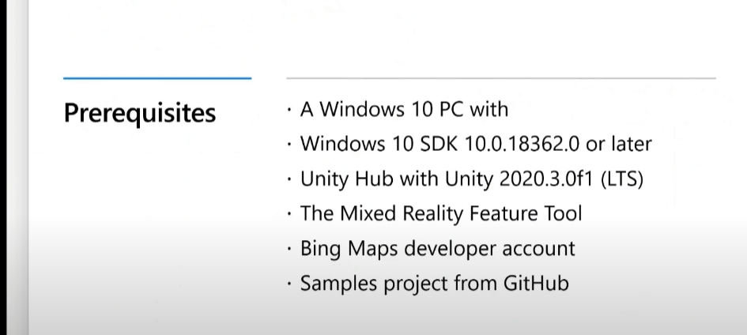

Slide 10
